Slide 1

Wishlists
Sign In
or
Sign Up
FULL NAME
Plan your gifts and take control of your life’s gifts
Insert your full name
EMAIL
Insert your email here
PASSWORD
*******
I agree to all statements in the terms and conditions
Sign Up

Slide 2
Wishlists
Sign In
or
Sign Up
EMAIL
Plan your gifts and take control of your life’s gifts
Insert your email here
PASSWORD
******
LOG IN

Slide 3
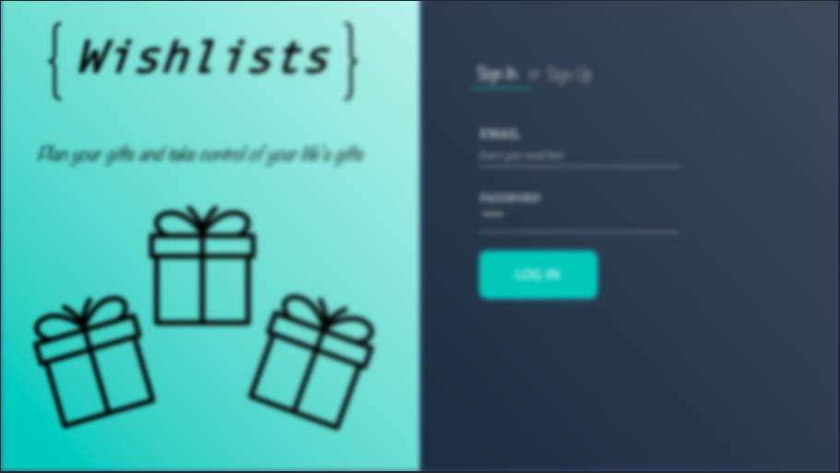
Welcome to Wishlists {User}! In order for this application to work properly, it requires the password for the email you logged in with!
Enter Password Here
I understand that password is not stored externally, and
will be deleted from the program’s memory
when I log out.
SUBMIT

Slide 4
Incorrect Username/Password!
RETRY

Slide 5
This email address is not signed up!
RETRY

Slide 6
This email address already has an associated account!
RETRY

Slide 7
Wishing Well
My Wishlists
Shared With Me

Slide 8





My Wishlists
Valentines Day
Valentines Day
Birthday
Items
White/Red roses
White chocolate
Ben & Jerries Ice Cream

Slide 9
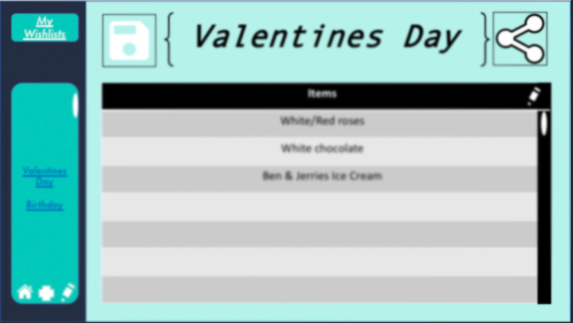
Please enter the name of the new wishlist you would like to create:
Enter Name Here
.
X
CREATE

Slide 10
Please enter the email of the user you would like to share to:
Enter Email Here
.
X
SEND

Slide 11
Please enter the email of the user you would like to share to:
Enter Email Here
.
X
SEND
ERROR: This email is not signed up! Please enter a correct email and press sign up

Slide 12
My Wishlists
Valentines Day
Valentines Day
Birthday
Items
White/Red roses
White chocolate
Ben & Jerries Ice Cream
X
X

Slide 13
My Wishlists
Valentines Day
Valentines Day
Birthday
Items
White/Red roses
White chocolate
Ben & Jerries Ice Cream
X
X
X

Slide 14
My Wishlists
Birthday
Valentines Day
Birthday
Items
Google Pixel 2 XL
JBL Bluetooth headphones
Bose Speaker or JBL Speaker
Cash
Not food
X
X
X
X
X

Slide 15
My Wishlists
Birthday
Valentines Day
Birthday
Items
Google Pixel 2 XL
JBL Bluetooth headphones
Bose Speaker or JBL Speaker
Cash
Not food

Slide 16
My Wishlists
Birthday
Valentines Day
Birthday
Items
Google Pixel 2 XL
JBL Bluetooth headphones
Bose Speaker or JBL Speaker
Cash
Not food
X
X

Slide 17
Shared Wishlists
Chloe
Lucy
Esha
Dani
Select a wishlist to view them!

Slide 18
Shared Wishlists
Chloe
Lucy
Esha
Dani
Select a wishlist to view them!
X
X
X
X

Slide 19
Shared Wishlists
Valentines Day
--By Chloe
Valentines Day
Birthday
Christmas
Items
Teeth
Hugs
Teddies
Chloe

Slide 20
Shared Wishlists
Birthday
--By Chloe
Valentines Day
Birthday
Christmas
T
The mortal instruments book 2
3 highlighters
Water bottle
Portable hard drive
Chloe

Slide 21
Shared Wishlists
Christmas
--By Chloe
Valentines Day
Birthday
Christmas
Items
Whiteboard Markers
Gluestick
15 GB USB
Text field
Chloe

Slide 22
Shared Wishlists
Valentines Day
--By Lucy
Valentines Day
Easter
Items
Ice cream
Pizza
More ice cream
Makeup
HUGS
Lucy

Slide 23
Shared Wishlists
Easter
--By Lucy
Valentines Day
Easter
Items
Big Oreo eggs
Lots of little white chocolate eggs
Flowers
Lucy

Slide 24
Shared Wishlists
Valentines Day
--By Esha
Valentines Day
18th Birthday
Items
Paints
Books
Nerd stuff
Typo aesthetics
Esha

Slide 25
Shared Wishlists
18th Birthday
--By Esha
Valentines Day
18th Birthday
Items
Folded Book in word ESHA
More books
Typo gift card
Esha

Slide 26
Shared Wishlists
Valentines Day
--By Dani
Valentines Day
Christmas
Items
Kale
Gym equipment
Gym clothes
Dani

Slide 27
Shared Wishlists
Christmas
--By Dani
Valentines Day
Christmas
Items
Unicorn themed clothing
Typo gift card
Muji pens
Dani

